Slide 1

Daily Recap

Slide 2





Independent vs dependent features/variables
Features:
In any dataset we can distinguish between two types of features/variables/columns:
Independent / predictive ( those that we will use to make predictions )
Dependent / Target ( WHAT want we want to predict USING the INDEPENDENT FEATURES )

Slide 3


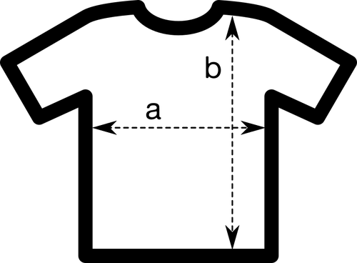
Types of features
Features:
There are always two types of features or variables:
Numerical: (numbers: 1, 2, 3…,3.15, 38.4)
Categorical (tags)
Ordinal ( they display some kind of order )
Nominal (they don’t have any order
Dates:
Usually we use date differences.
How we can distinguish between them?
Numericals express an amount (they can be added, subtracted, multiplied, divided..)
Categoricals doesn’t express an amount, express a tag.

Slide 4
Dealing with missing values
Drop rows
Drop them
Drop columns
NA’s
Custom replacement
Replace them
Imputation methods

Slide 5

Encoding data
Numerical
Features
Nominals
One Hot Encoding
Categoricals
Ordinals encoding
Ordinals

Slide 6
Introduction to machine learning
The case where we do not have data on an outcome.
Clustering is the most common UL problem: grouping data points with the ones where they share most characteristics.
We can’t evaluate the performance (depending on the question there may be other ways to evaluate)
Un supervised learning

Slide 7
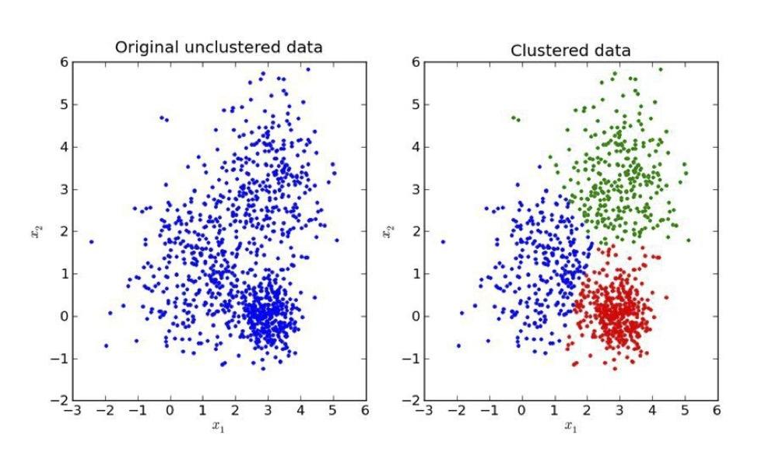
Introduction to machine learning
Clustering is the process of grouping data without telling the computer to which group belongs every observation.
Clustering

Slide 8
Introduction to machine learning
For K number of groups, pick K random locations (centroids)
Calculate the distance of each observation to every centroid.
Assign every observation to the nearest centroid.
Adjust centroids locations to the mean location of every member of the cluster
Repeat until centroid locations doesn’t change significantly (to be defined)
K-Means

Slide 9
Sklearn
Transformers are stored in preprocessing module of sklearn library
from sklearn.preprocessing import transformer
Available transformers:
StandardScaler()
MinMaxScaler()
PowerTransformer()
QuantileTransformer()
RobustScaler()
Normalizer()
OrdinalEncoder()
OneHotEncoder()
Scikit-learn transformers

Slide 10
Transformers need to gather some information from the dataset in order to apply a transformation.
They operate in two steps using the methods fit() and transform():
transformer.fit(df)
transformer.transform(df)
Both steps can be combined in a single method fit_transform():
transformer.fit_transform(df)
They always return a np.array.
If a df is desired, use pd.DataFrame(numpy.array, columns=...)
Sklearn
Scikit-learn transformers

Slide 11

Sklearn
This transformer does the following:
Compute:
mean of every column
standard deviation of every column
For every value of a column, it substracts the column’s mean and divide by the standard deviation of the column.
Scikit-learn StandardScaler()

Slide 12
Sklearn
There are three main methods to determine the best K value:
Business restrictions/knowledge
Elbow method
Silhouette method
Scikit-learn KMeans best K?

Slide 13
Sklearn
Your boss demanded a specific number of groups? (money costs talks)
Does it makes sense to have so many or few groups?
What is a reasonable amount of groups?
KMeans best K: business restrictions

Slide 14
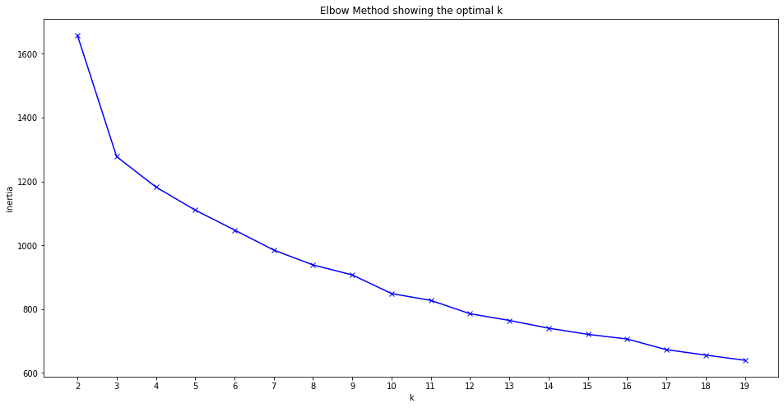
Sklearn
This method computes the average distance between every member of a cluster and the centroid of the cluster to which belongs as a function of the number of clusters.
The best number of clusters is the one for which previous amount doesn’t drop significantly.
KMeans best K: elbow method

Slide 15

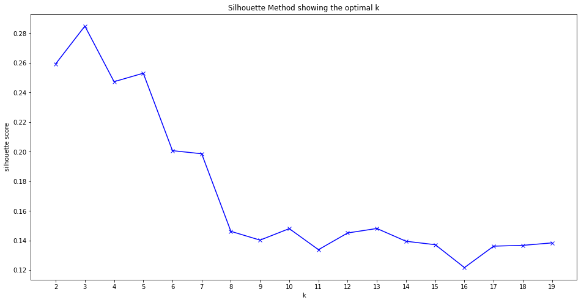
Sklearn
This method computes the “goodness” of the clustering based on:
Mean intracluster distance = a
Mean nearest cluster distance = b
The Silhouette score is given by:
The best number of cluster is selected as the one with the best score.
KMeans best K: silhouette method

Slide 16
Pickle
Now we have a transformer and a model already trained. How we can store them?
The answer is the pickle library:
import pickle
To save the pickle:
def save(amount, filename = “filename.pickle”):
with open(filename, "wb") as f:
pickle.dump(amount, f)
To restore the pickle:
def load(filename = “filename.pickle”):
try:
with open(filename, "rb") as f:
return pickle.load(f)
except FileNotFoundError:
print(“File not found!”)
Pickle: saving and loading objects

